Slide 1
SolidWorks SustainabilityXpress Program Overview
engineering
Notes:
Before you begin, ask your audience –What are your objectives for your students? What type of activities do your students work on? That way you can focus on “communication skills”, “drawing skills”, “math” as you work your way through.

Slide 2
What is Sustainable Engineering?
Sustainable engineering is the integration of social, environmental, and economic conditions into a product or process
Soon all design will be Sustainable Design
SolidWorks SustainabilityXpress allows students to be environmentally conscious about their designs
Successful products are developed by integrating Life Cycle Assessment (LCA) directly into Computer Aided Design (CAD)

Slide 3
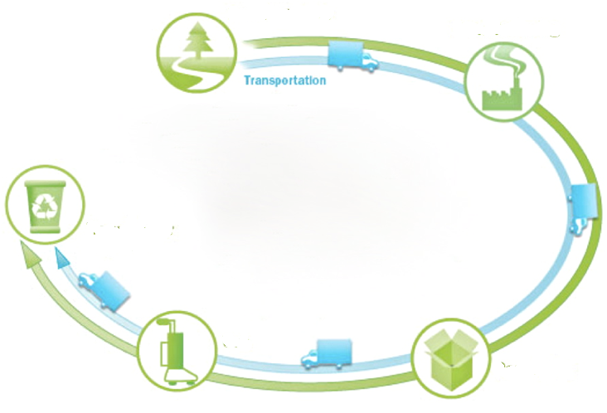
LCA – Life Cycle Assessment
Raw Materials
Manufacturing
Recycle
Use
Packaging
Notes:
By integrating LCA (Life Cycle Assessment), users can see how decisions about material, manufacturing, and location (manufacturing and use) influence a design’s environmental impact. Users specify no more than five inputs, which the LCA technology uses to do a comprehensive evaluation of all the steps in a design’s life.
Life Cycle Assessment:
Ore extraction from the earth
Material processing
Part manufacture
Assembly
Use of the product by the end consumer
End of Life (EoL) – landfill, recycled, incineration
All the transportation which occurs between and within each of these steps.
As all of the steps in the life cycle are assessed, the results are distilled down into environmental impact factors which are measured and totaled.
Environmental Impact Factors:
Carbon Footprint – Carbon dioxide and equivalents that are released into the atmosphere which result in global warming.
Air Acidification – Primarily due to the burning of fossil fuels which eventually leads to acid rain.
Water Eutrophication – Fertilizers travel via rivers to coastal waters which results in algae blooms and the eventual killing of all sea life in certain coastal regions.
Energy Consumed – Over the entire life cycle of the product.

Slide 4
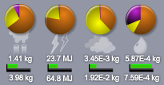
SolidWorks SustainabilityXpress measures
Environmental Impacts
Carbon Footprint
Energy Consumed
Air Acidification
Water Eutrophication
Notes:
By integrating LCA (Life Cycle Assessment), users can see how decisions about material, manufacturing, and location (manufacturing and use) influence a design’s environmental impact. Users specify no more than five inputs, which the LCA technology uses to do a comprehensive evaluation of all the steps in a design’s life.
Life Cycle Assessment:
Ore extraction from the earth
Material processing
Part manufacture
Assembly
Use of the product by the end consumer
End of Life (EoL) – landfill, recycled, incineration
All the transportation which occurs between and within each of these steps.
As all of the steps in the life cycle are assessed, the results are distilled down into environmental impact factors which are measured and totaled.
Environmental Impact Factors:
Carbon Footprint – Carbon dioxide and equivalents that are released into the atmosphere which result in global warming.
Air Acidification – Primarily due to the burning of fossil fuels which eventually leads to acid rain.
Water Eutrophication – Fertilizers travel via rivers to coastal waters which results in algae blooms and the eventual killing of all sea life in certain coastal regions.
Energy Consumed – Over the entire life cycle of the product.

Slide 5
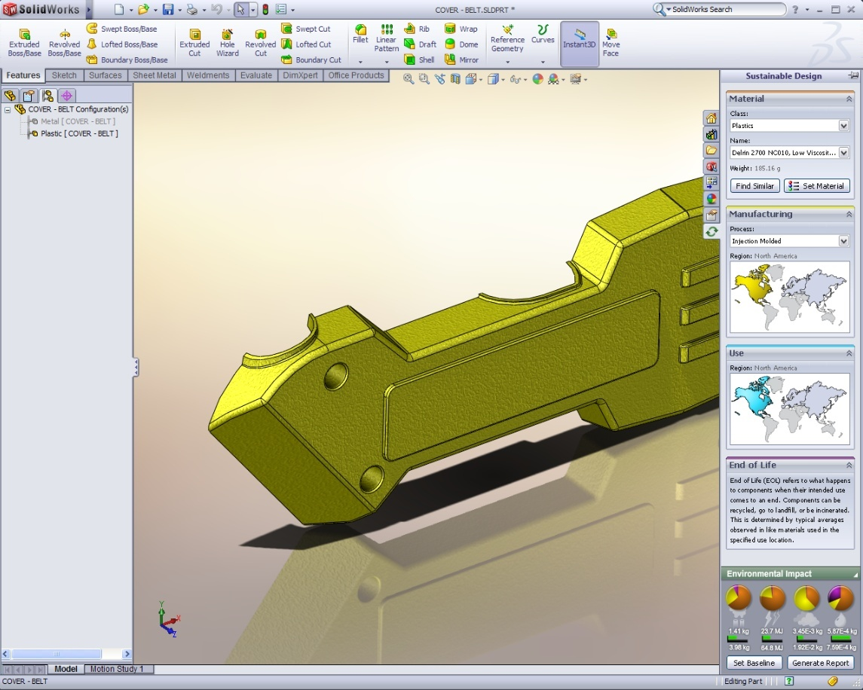
SolidWorks SustainabilityXpress
Environmental Impacts
Carbon Footprint
Energy Consumed
Air Acidification
Water Eutrophication
Notes:
The Project Sage UI allows the user to specify:
Material
Manufacturing process
Manufacturing location
Use location
The Environmental Impact Factors are shown at the bottom of the screen in the Dashboard.

Slide 6
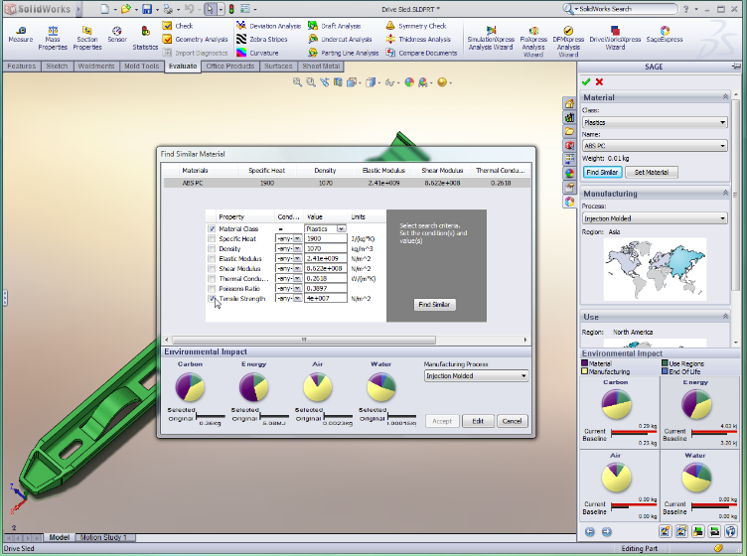
Why SolidWorks SustainabilityExpress in the classroom?

Slide 7
Why SolidWorks SustainabilityXPress in the classroom?
Students need to learn, understand, improve, and communicate the environmental impact of their design
Educators can provide insights on how choices in material and manufacturing processes affect the environment.
Instruction combines design and technology with the social, environmental, and economic conditions

Slide 8
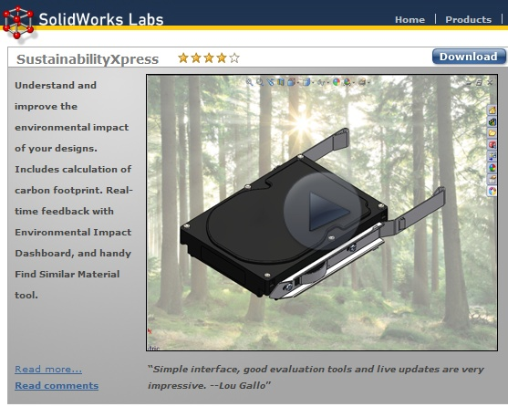
SolidWorks SustainabilityXpress
Go to: http://labs.SolidWorks.com

